Slide 1



BMPTRAINS Model: Background information on Harvesting
By: Marty wanielista, Phd., P.E.

Slide 2
Methodologies: Rain and Stormwater Harvesting (Reuse)
From BMPTRAINS Model (FDOT and UCF)

Slide 3
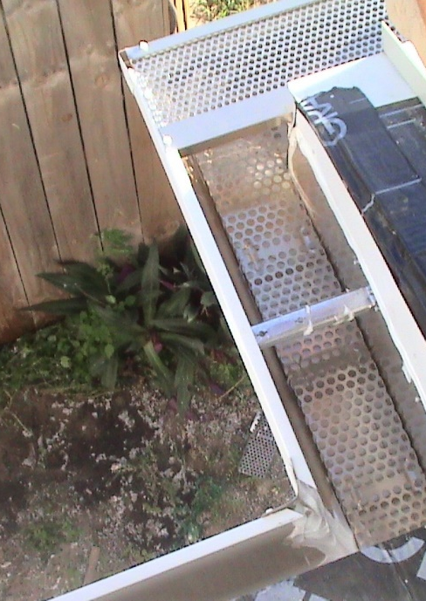
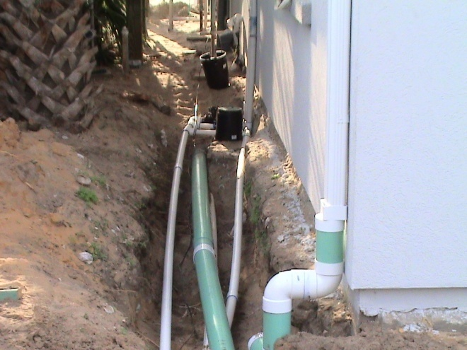
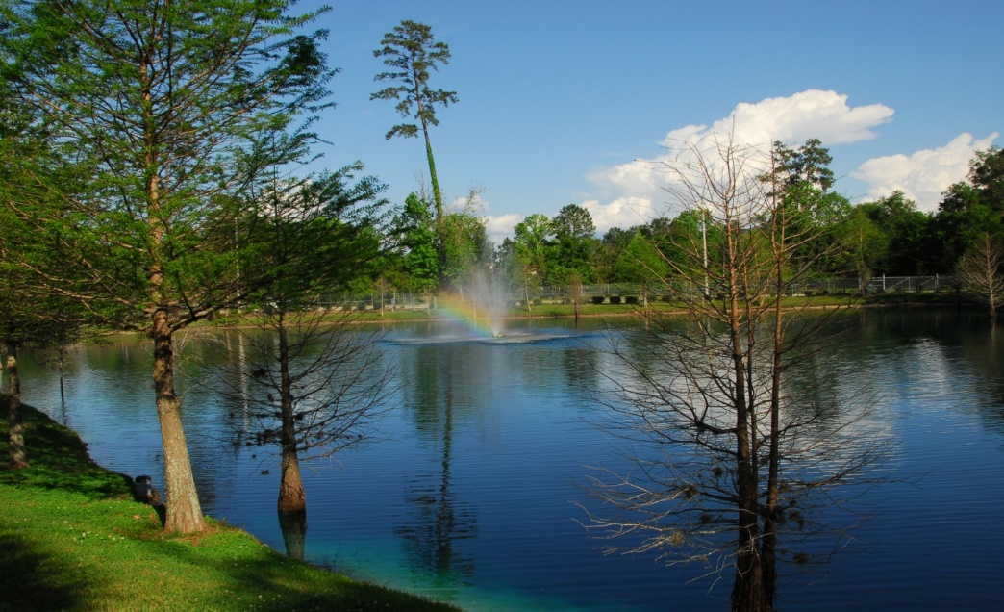
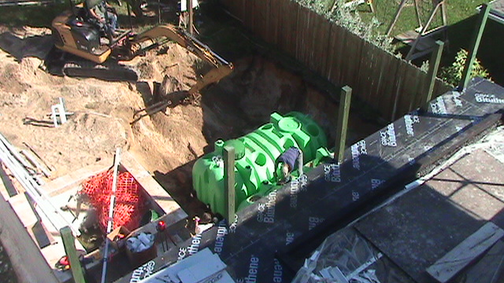
Differences between rainfall and stormwater harvesting
Rainwater: Source of water is from a building
Stormwater: Source of water is from a land use, such as highway, parking lot, building plus surrounding land cover.
RAINWATER STORMWATER

Slide 4
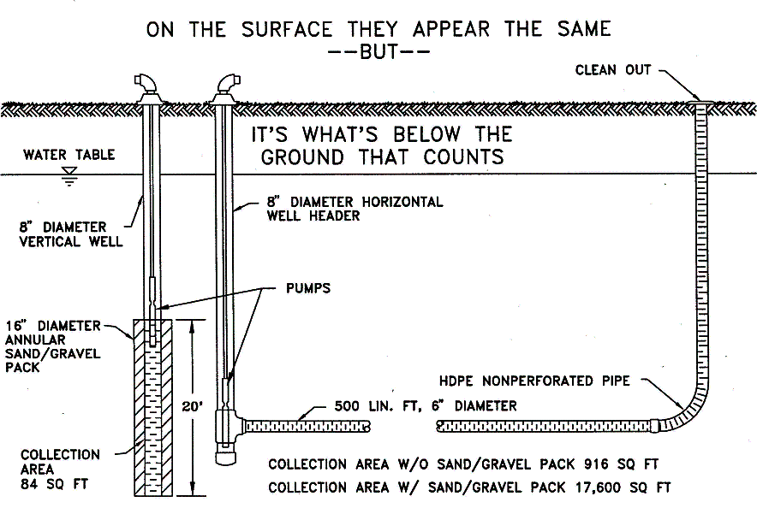
For Harvesting Recommend Filtration by Horizontal Well, disc filter or Sand Filtration
(Horizontal well less cone of depression)
PUMP lift is limited to 20 feet
Notes:
4

Slide 5
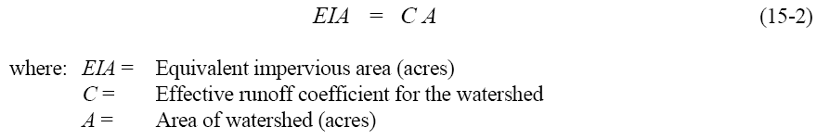
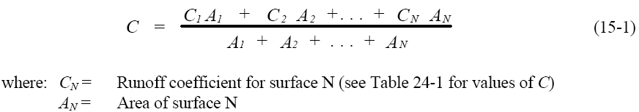
Some Definitions
C Factor calculated for the assumed runoff storage volume (inches)

Slide 6
Basis of the REV curves
REV is an acronym for Rate of reuse, Effectiveness, and Volume of the storage above the permanent pool.
A REV curve reflects the relationship between the size of the runoff Volume and the Rate of reuse that results in an average annual Effectiveness defined as the % capture of runoff not discharged.
The REV curves were determined from:
  Actual rainfall data simulated for at least 15 years
  Assuming irrigation rates over the EIA for two days/week
  With no irrigation when it rained in the previous 24hrs
  A blockage of the pollution control volume
  Fixing 20 volumes of storage above permanent pool.

Slide 7
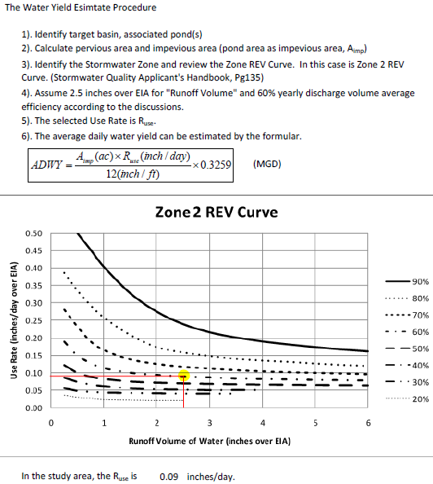
REV Curve (Given 2 parameters, calculate the remaining one)
FOR all 5 Rainfall regions of the State of Florida

Slide 8
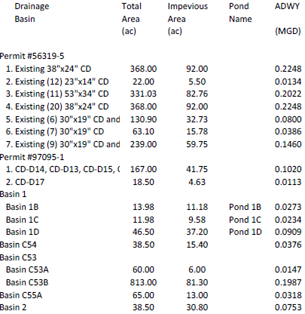
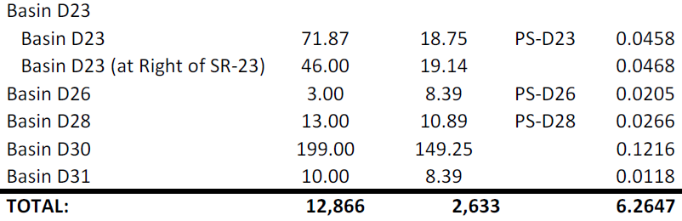
REV Curve Calculation Results
Total 50 drainage basins or study areas
12,866 acres
Calculated water yield 6.26 MGD
Source: GAI Orlando office

Slide 9
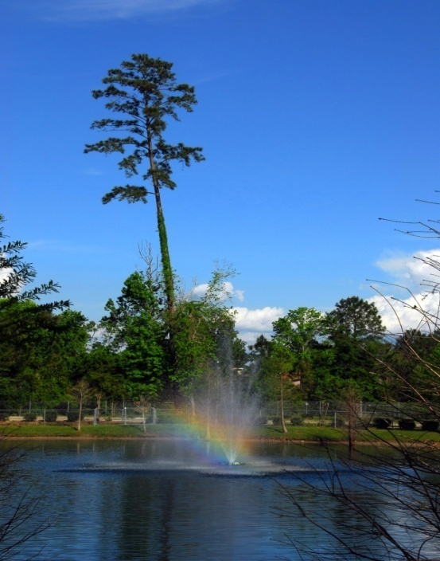
Enhanced Nitrogen Removal of a Detention Pond by Harvesting the Detained Water (note: same catchment)
Nitrogen Removal Example
Reuse
Area
Pond Effectiveness
100
Reuse %
Control
67% effective
33
Structural
Control
40%
effective
20
67
13
Photo Credit
FDOT

Slide 10
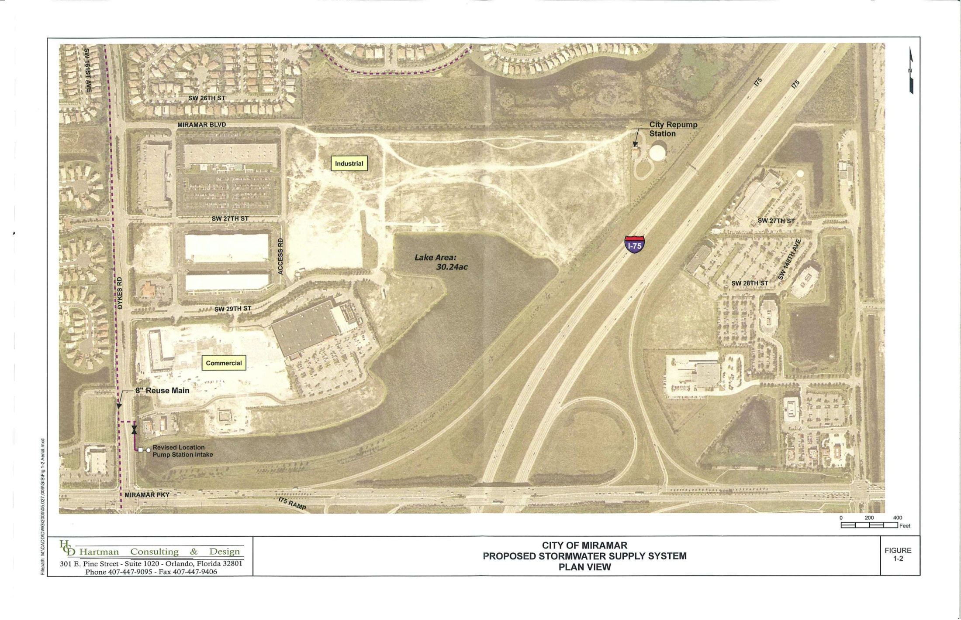

City of Miramar – Supplement Reclaimed Water
Source Estimated Capital Cost - $1.3 Million
Capacity – 1 MGD
Cost per 1,000 gallons (Reclaimed & Harvested IQ) - $0.80/1,000 gallons
pond

Slide 11


Golf Course and I-4 Stormwater Management Plan
Plan – Provide water on golf course to improve the play and image of the course.
FDOT – We got the water for you.
WIN WIN FDOT and a high school gets stormwater plans, citizens get a real golf course.
All get stormwater treatment and saving of potable water that would otherwise be used for irrigation.
And oh yes, Wekiva is protected.
Notes:
11

Slide 12
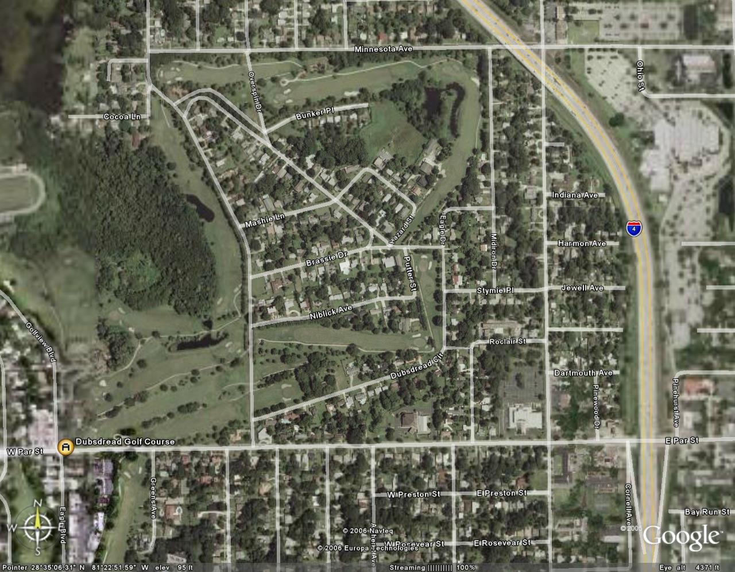
FDOT District Signature Project
Notes:
12

Slide 13

Questions, remarks and discussion
Thank you!

