Slide 1



BMPTRAINS Model: Background information on swales
By: Marty wanielista, Phd., P.E.

Slide 2
Methodologies SWALES
From Avellaneda, Eduardo. 1985. M.S. Thesis, UCF

Slide 3
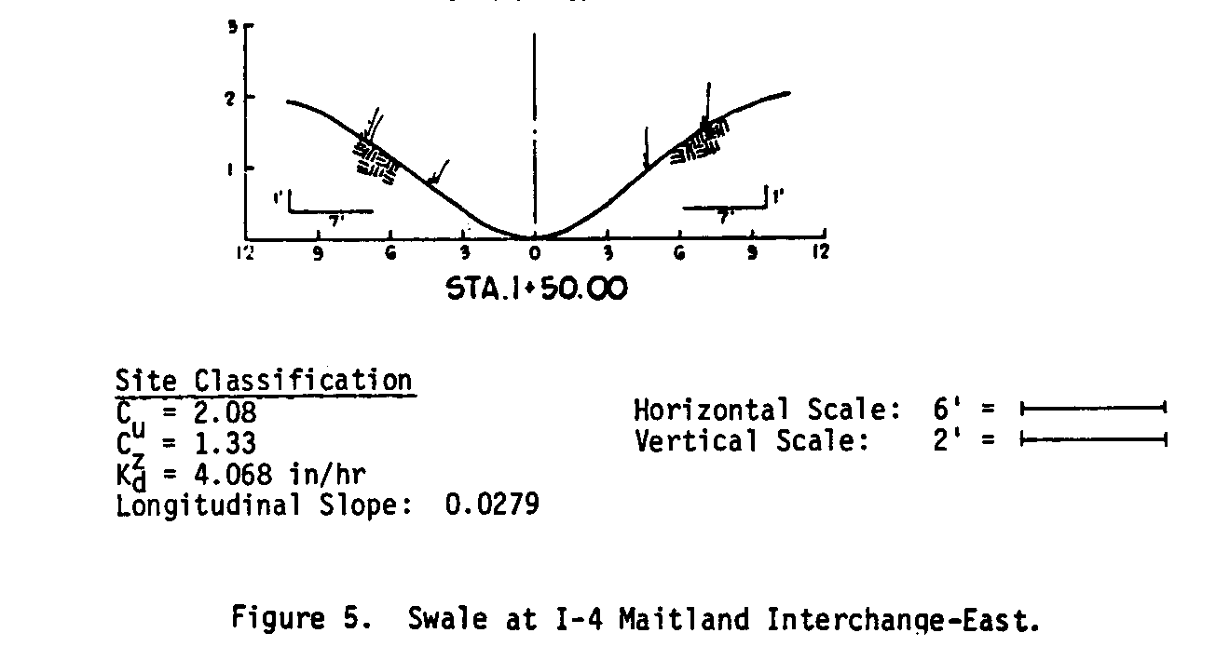
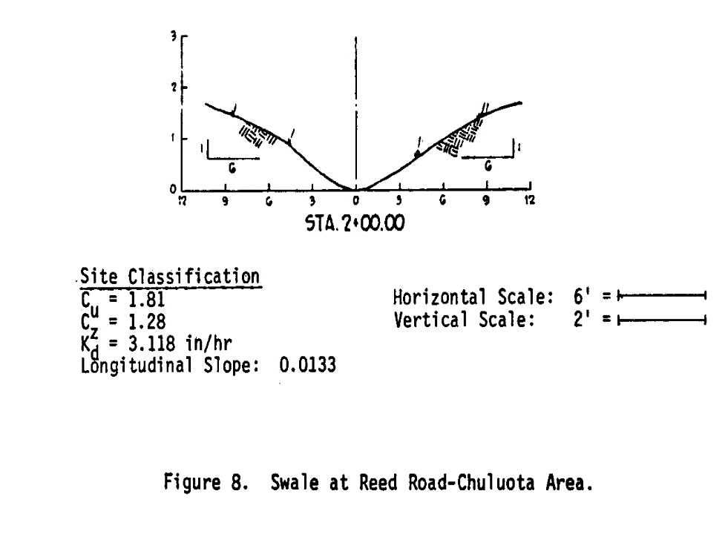
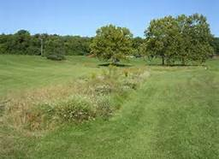
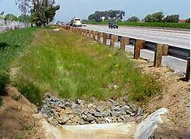
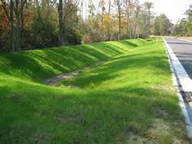
Field and Lab Measurements

Slide 4
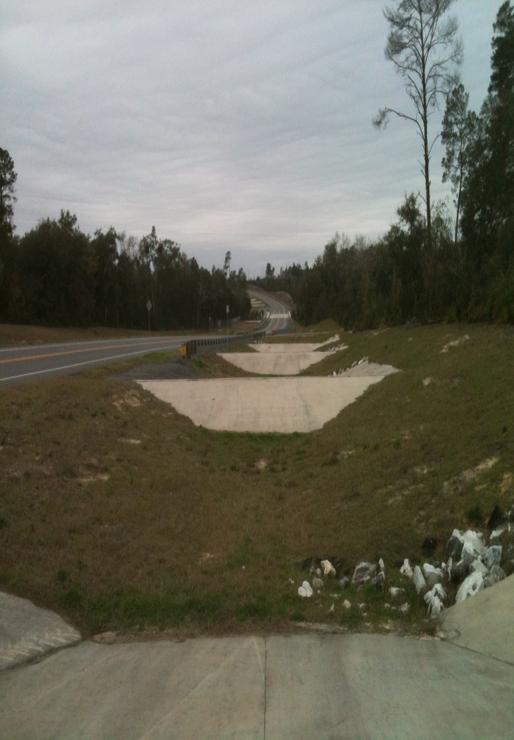
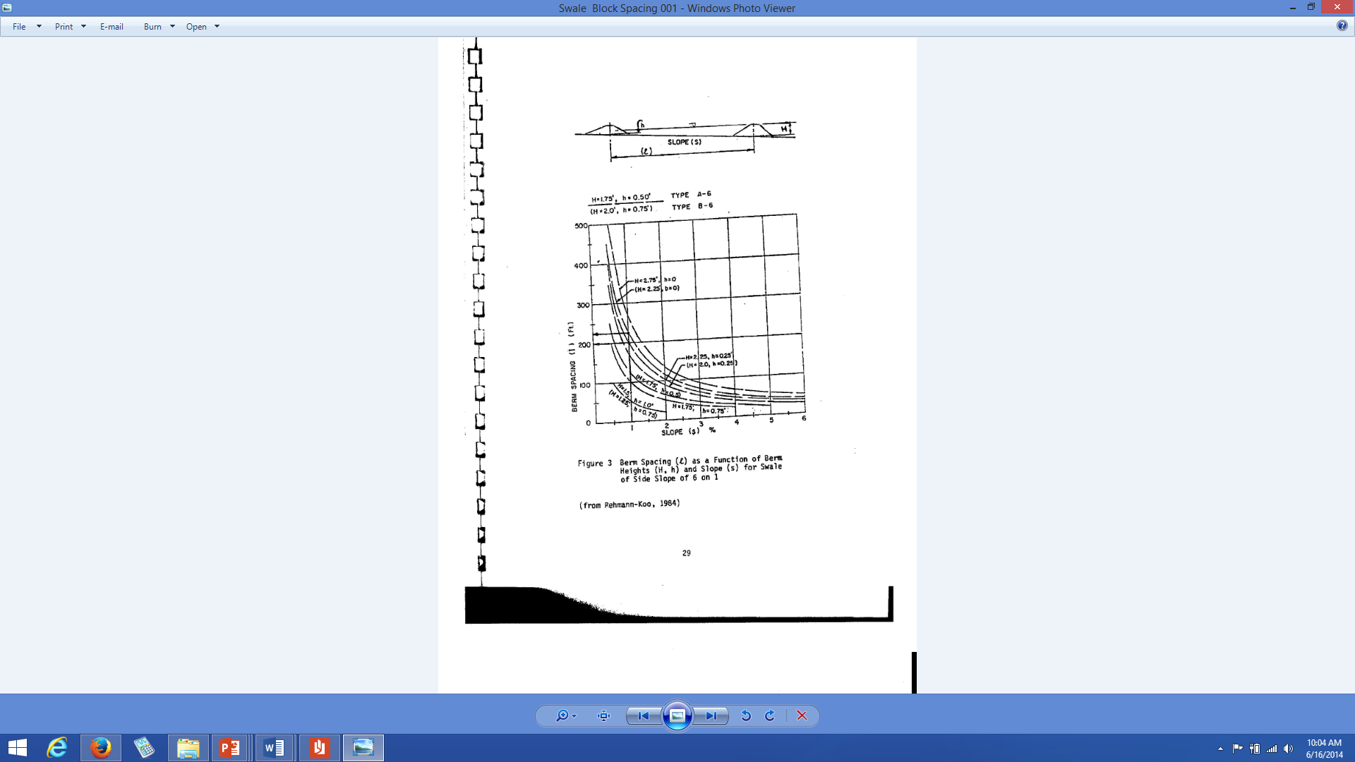
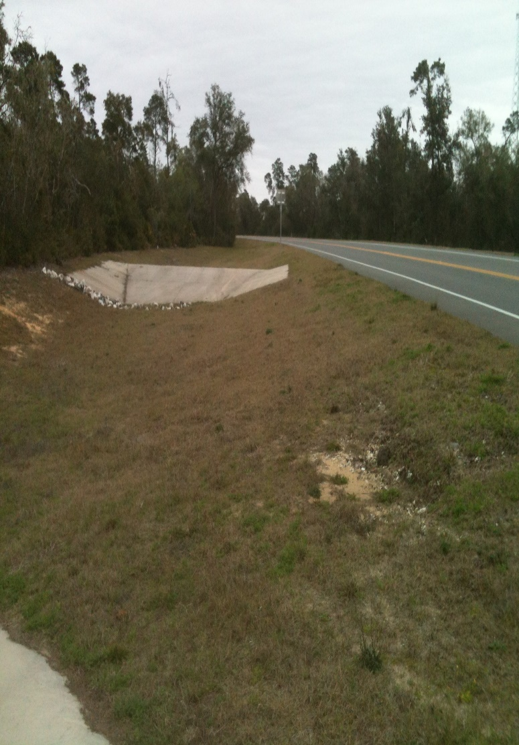
Graph to aid in spacing
80% Capture
5% slope
Downstream
Upstream

Slide 5
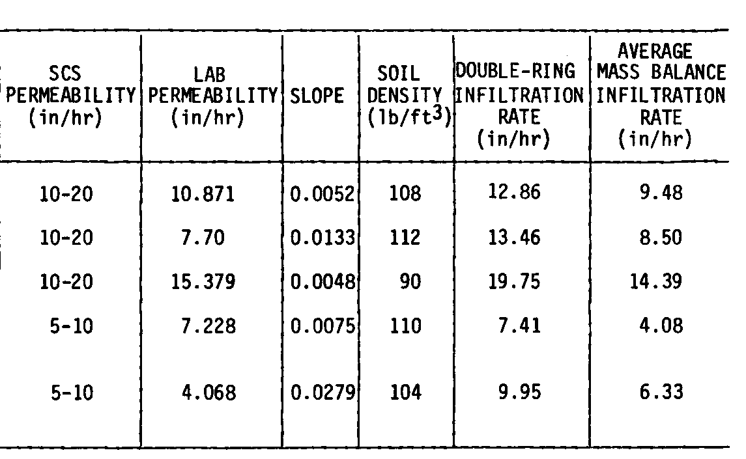
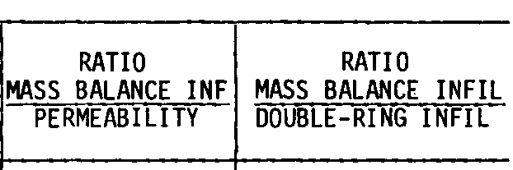
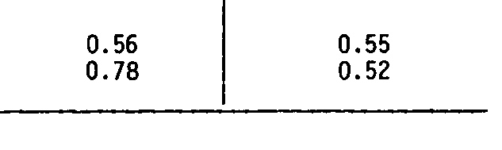
Ratio of Lab and Field Measurements

Slide 6
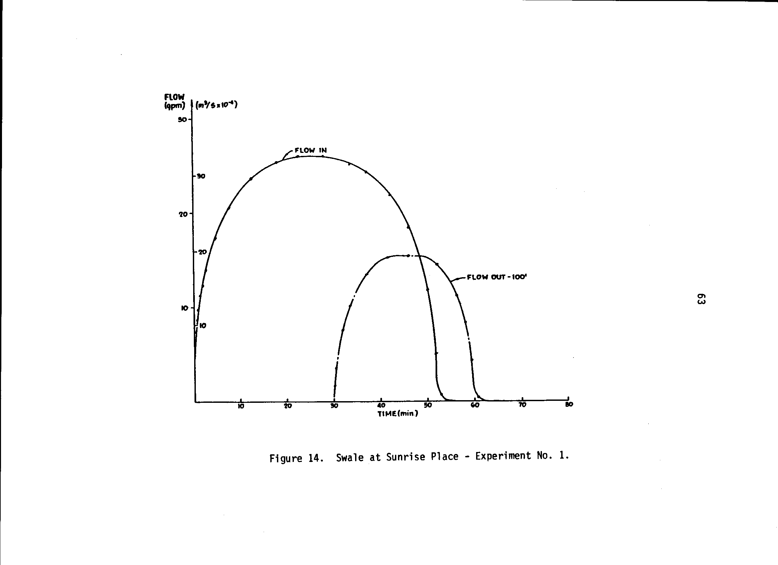
Hydrograph with swale block
Mass balance average infiltration rate about 5 inches/hour

Slide 7
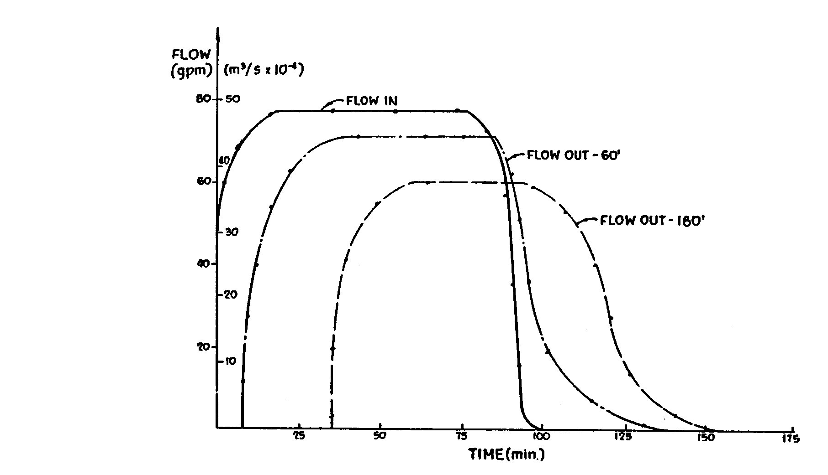
Swale without Swale Block
Mass balance average infiltration rate about 2 inches/hour

Slide 8
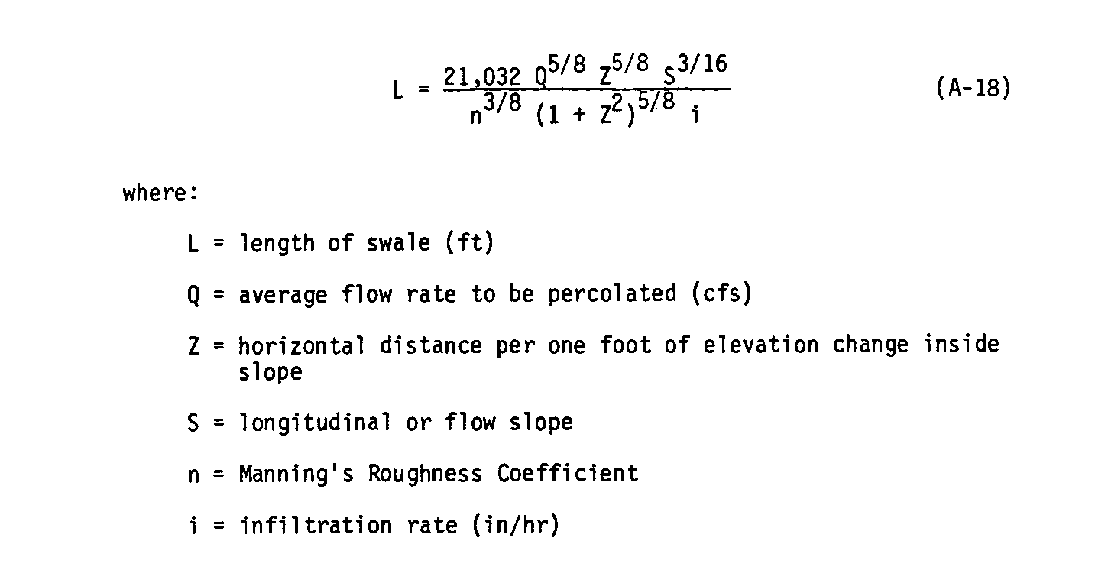
Programming of Equations
( an example)

Slide 9
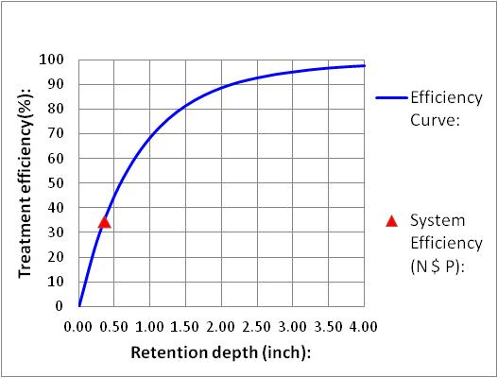
Example Output Swale Design

Slide 10

Questions, remarks and discussion
Thank you!

