Slide 1
Porous Pavement Example
By: Mike Hardin, PhD, PE, CFM
BMPTRAINS Model Training Course
1/28/2016
UNIVERSITY OF
CENTRAL FLORIDA
STORMWATER MANAGEMENT ACADEMY

Slide 2
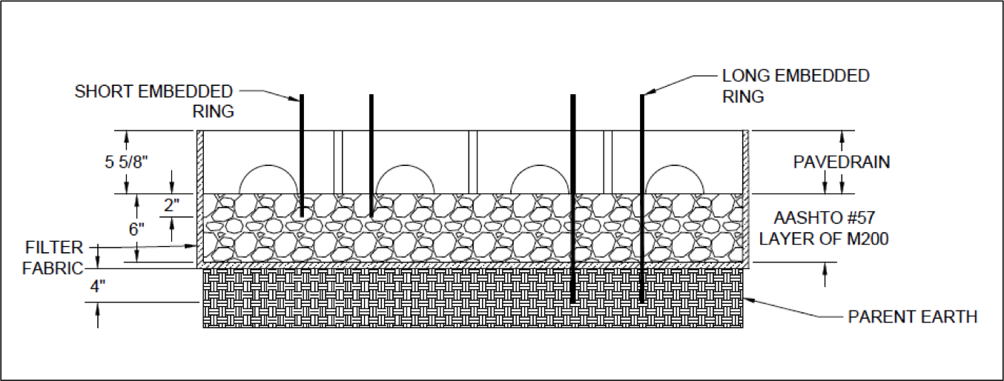
Problem Setup
Evaluate a PaveDrain section design
Assume
Orlando Florida
Total project area = 1.5 acres
Total parking lot area = 0.8 acre
Undeveloped Upland Hardwood – predevelopment
Low intensity commercial – post development
Net improvement treatment goals

Slide 3
Model Setup
Click here to begin

Slide 4
Model Setup
Input data
State Maps for zone and rainfall
Next worksheet
Model Reset

Slide 5
Model Setup
Next worksheet
Site configuration
Input data
Loading data

Slide 6
Model Setup
Treatment Objectives
BMP Worksheets
Site configuration
Results worksheet

Slide 7
Model Setup
Porous Pavement Area
System Details
Treatment curve

Slide 8
Results
BMP used
Summary of Results
Provided Treatment

Slide 9
Questions?
Mike Hardin
mhardin@geosyntec.com
(321)244-1464

